Slide 1
Lesson 09 Two Sample Z-test and t-test Interactive Seminar E214 – Statistical Methods for Engineering

Slide 2
Pre-lesson activity
[Class Discussion & Sharing]
2

Slide 3
E214 – Statistical Methods for Engineering
Inferential Statistics
Hypothesis Testing
Parameter Estimation
Organize & summarize data collected
Probability and Distributions
Venn Diagram
Discrete Random Variables and Probability Distributions
Probability Distributions
Descriptive Statistics
Continuous Random Variables and Probability Distributions
Binomial Distribution
Poisson Distribution
Normal Distribution
Exponential Distribution
Tree Diagram
A more detailed topic tree on Hypothesis Testing will be given from P08 onwards
3

Slide 4
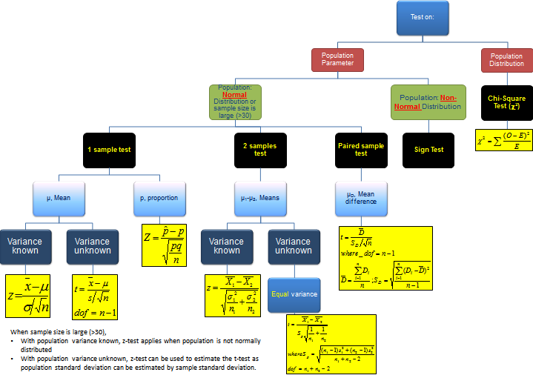
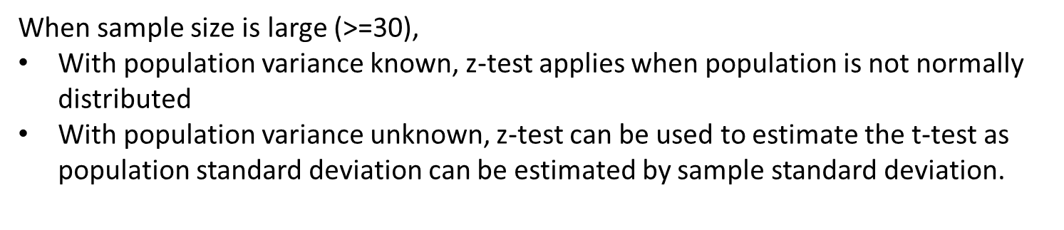
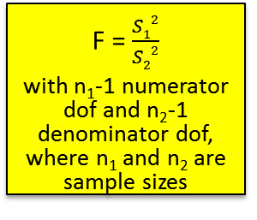
Topic Tree for Hypothesis Testing
ANOVA
A tool to compare the means of several (3 or more) populations with a single test.
L09
2 samples test on variance
σ₁² – σ₂²
F = $\frac{S12}{S22}$
with n₁-1 numerator dof and n₂-1 denominator dof, where n₁ and n₂ are sample sizes

Slide 5

Scenario
The bone density of a person can be measured by a medical procedure, and measurements are most commonly taken over the lumbar spine and the upper part of the hip.
Three medical research students, Aaron, Bernice and Collin, are required to conduct research relating to human bone density as one of their assignments.

Slide 6
Scenario: Test A
Aaron read a medical research paper that reported a study which shows that male citizens from the United States, aged between 18 to 25 years, has significantly higher bone density than that of females from the same age group and nationality. He wants to find out if the same applies to Singaporeans of the same age group.
He obtained sample data from a local hospital comprising of bone densities of 50 males and 50 females from this age group. The sample data collected is in the Excel spreadsheet below. Help Aaron conduct a suitable test.

Slide 7
[Recall] Overview of Hypothesis Testing Procedure
From the problem, identify the population parameter of interest.
State clearly the null hypothesis H₀ and alternative hypothesis H₁.
State clearly the level of significance of the test (if not given in problem, we can assume a typical value of 1%, 2% or 5%).
State the test statistic to be used, together with any necessary assumptions made.
Compute the value of the test statistic using the given sample data.
6. i) If using the critical region method: based on the stated level of significance , determine the critical value(s) and state the critical region.
ii) If using p-value method: based on the calculated value of the test statistic, calculate the p-value.
7. Make a decision whether to reject H₀:
i) If using critical region method: Reject H₀ if calculated test statistic falls inside the critical region. Otherwise, do not reject H_{0.}
ii) If using p-value approach: Reject H₀ if p-value < level of significance. Otherwise, do not reject H_{0.}
8. Write down a formal conclusion for the problem in its context.

Slide 8
Dependent or Related Samples
Sometimes, samples under study are related or they contain the same subjects but under different conditions. These are known as dependent or related samples.
Examples of dependent samples:
Performance of workers before and after a training program
Comparison of IQ scores of pairs of children matched with the same age (to block out the differences in scores due to age)

Slide 9
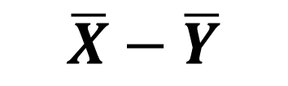

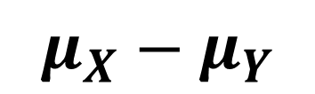
Independent VS Dependent Populations
Independent
Dependent
Independent data sources
Test statistic uses difference between the 2 sample means
The population parameter of interest is
Hypothesis test is called two-sample test
Same data source
Paired/matched
Repeated measures (Before/after)
Test statistic uses difference between each pair of observations
D_{i} = X_{1i} - X_{2i}
The population parameter of interest is
Hypothesis test is called paired t-test
$$\overline{X}−\overline{Y}$$
$$μ_{X}−μ_{Y}$$
$$μD$$

Slide 10
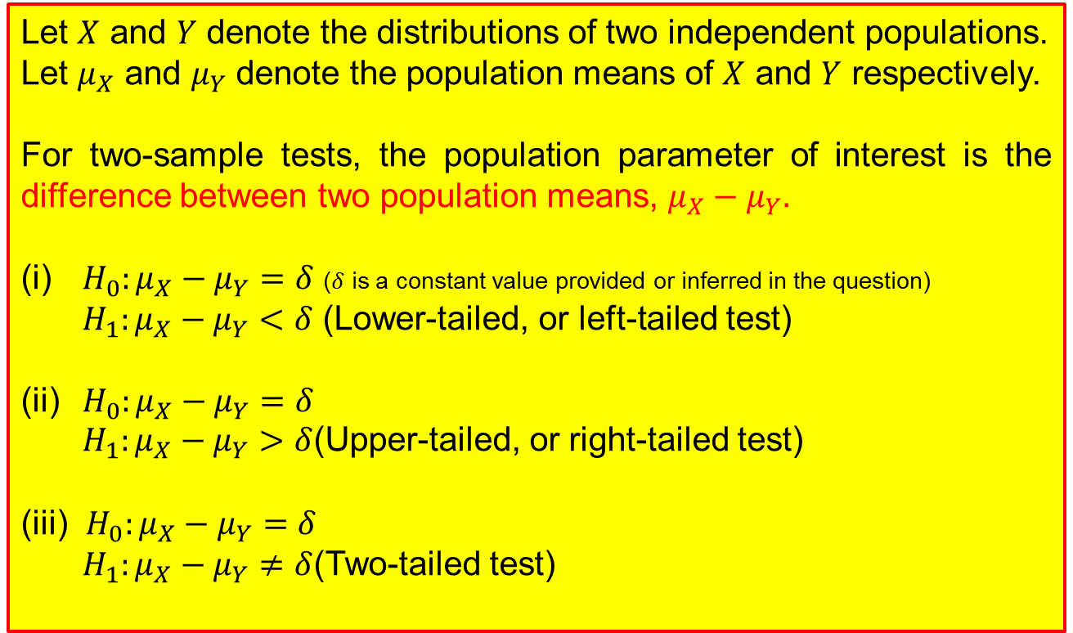
Two-sample Tests for Difference Between Two Population Means (for Independent Populations): Formulation of Null and Alternative Hypotheses
Let $X$ and $Y$ denote the distributions of two independent populations.
Let $μ_{X}$ and $μ_{Y}$ denote the population means of $X$ and $Y$ respectively.
For two-sample tests, the population parameter of interest is the difference between two population means, $μ_{X}−μ_{Y}.$
(i) $H_{0}:μ_{X}−μ_{Y}=δ$ ($δ$ is a constant value provided or inferred in the question)
$H_{1}:μ_{X}−μ_{Y}<δ$ (Lower-tailed, or left-tailed test)
(ii) $H_{0}:μ_{X}−μ_{Y}=δ$
$H_{1}:μ_{X}−μ_{Y}>δ$(Upper-tailed, or right-tailed test)
(iii) $H_{0}:μ_{X}−μ_{Y}=δ$
$H_{1}:μ_{X}−μ_{Y}≠δ$(Two-tailed test)

Slide 11
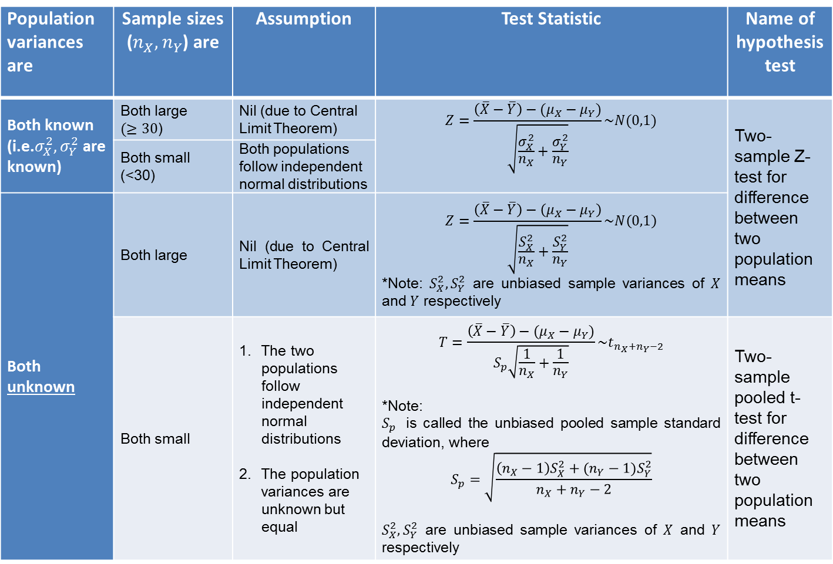
Two-sample Tests for Difference Between Two Population Means (for Independent Populations): Test Statistics
Population variances are | Sample sizes ($n_{X},n_{Y}$) are | Assumption | Test Statistic | Name of hypothesis test
Both known (i.e.$σ_{X}^{2},σ_{Y}^{2}$ are known) | Both large $(≥30$) | Nil (due to Central Limit Theorem) | $$Z=\frac{\left(\overline{X}−\overline{Y}\right)−(μ_{X}−μ_{Y})}{\sqrt{\frac{σ_{X}^{2}}{n_{X}}+\frac{σ_{Y}^{2}}{n_{Y}}}}\sim N(0,1)$$ | Two-sample Z-test for difference between two population means
 | Both small (<30) | Both populations follow independent normal distributions
Both unknown | Both large | Nil (due to Central Limit Theorem) | $$Z=\frac{\left(\overline{X}−\overline{Y}\right)−\left(μ_{X}−μ_{Y}\right)}{\sqrt{\frac{S_{X}^{2}}{n_{X}}+\frac{S_{Y}^{2}}{n_{Y}}}}\sim N\left(0,1\right)$$ *Note: $S_{X}^{2},S_{Y}^{2}$ are unbiased sample variances of $X$ and $Y$ respectively
 | Both small | The two populations follow independent normal distributions The population variances are unknown but equal | $$T=\frac{\left(\overline{X}−\overline{Y}\right)−(μ_{X}−μ_{Y})}{S_{p}\sqrt{\frac{1}{n_{X}}+\frac{1}{n_{Y}}}}\sim t_{n_{X}+n_{Y}−2}$$ *Note: $S_{p}$ is called the unbiased pooled sample standard deviation, where $$S_{p}=\sqrt{\frac{\left(n_{X}−1\right)S_{X}^{2}+(n_{Y}−1)S_{Y}^{2}}{n_{X}+n_{Y}−2}}$$ $S_{X}^{2},S_{Y}^{2}$ are unbiased sample variances of $X$ and $Y$ respectively | Two-sample pooled t-test for difference between two population means
11

Slide 12



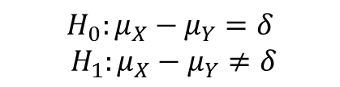


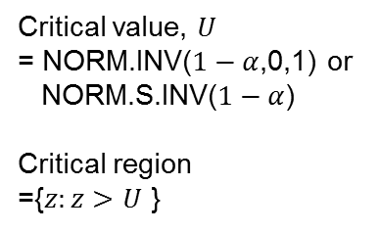
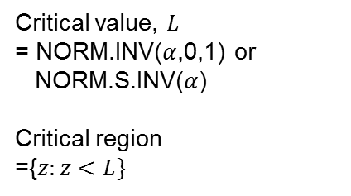
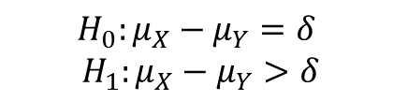





Critical Value(s) and Critical Region for Z Test Statistic
$$H_{0}:μ_{X}−μ_{Y}=δ$$
$${ H}_{1}:μ_{X}−μ_{Y}<δ$$
$$H_{0}:μ_{X}−μ_{Y}=δ$$
$${ H}_{1}:μ_{X}−μ_{Y}≠δ$$
$$H_{0}:μ_{X}−μ_{Y}=δ$$
$${ H}_{1}:μ_{X}−μ_{Y}>δ$$
(Lower-tailed test)
(Two-tailed test)
(Upper-tailed test)
Z~N(0,1)
Z~N(0,1)
Z~N(0,1)
$$α$$
$$α/2$$
$$α/2$$
$$α$$
$$L$$
0
$L$
0
$$U$$
0
$$U$$
Critical value, $L$
= NORM.INV($α$,0,1) or
NORM.S.INV($α$)
Critical region
={$z:z<L\}$
Lower critical value, $L$
= NORM.INV($\frac{α}{2},0,1)$ or NORM.S.INV($\frac{α}{2}$)
Upper critical value, $U=−L$
Critical region
= $\{z:z<L$or $z>U\}$
Critical value, $U$
= NORM.INV($1−α$,0,1) or
NORM.S.INV($1−α$)
Critical region
={$z:z>$ $U$ }

Slide 13
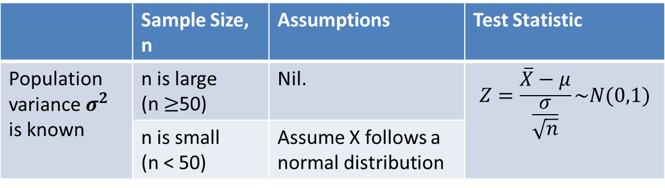
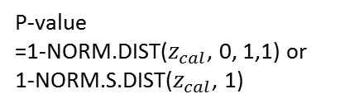

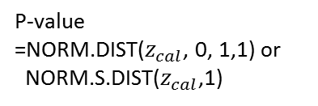
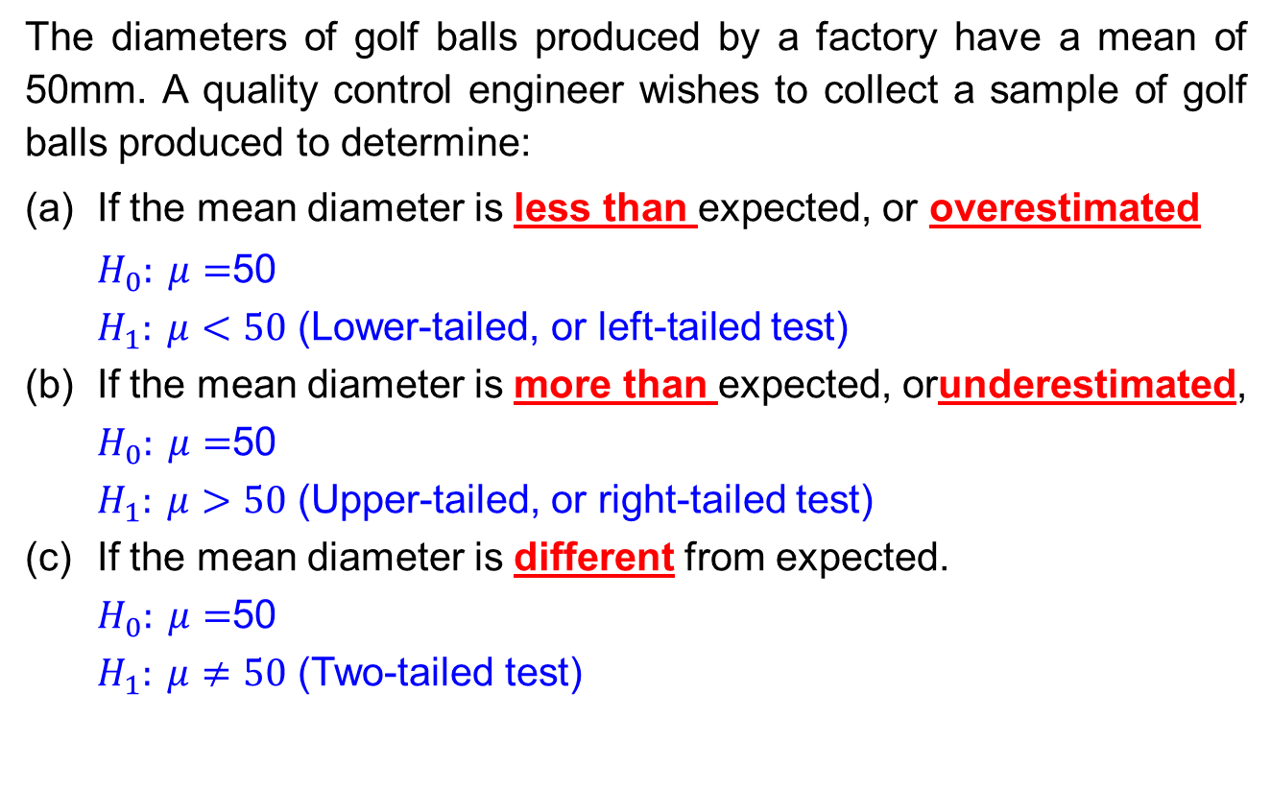
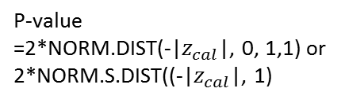
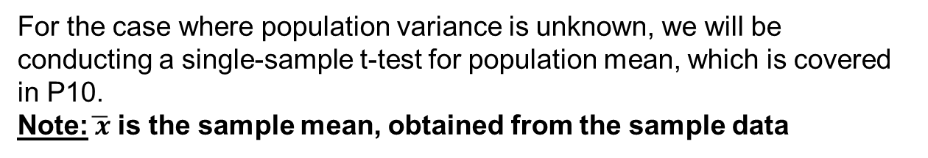
P-value for Z Test Statistic
$$H_{0}:μ_{X}−μ_{Y}=δ$$
$${ H}_{1}:μ_{X}−μ_{Y}<δ$$
$$H_{0}:μ_{X}−μ_{Y}=δ$$
$${ H}_{1}:μ_{X}−μ_{Y}≠δ$$
$$H_{0}:μ_{X}−μ_{Y}=δ$$
$${ H}_{1}:μ_{X}−μ_{Y}>δ$$
(Lower-tailed test)
(Two-tailed test)
(Upper-tailed test)
Z~N(0,1)
p-value
Z~N(0,1)
p-value
Z~N(0,1)
p-value
$$z_{cal}$$
0
-${|z}_{cal}|$
0
$${|z}_{cal}|$$
0
$$z_{cal}$$
P-value
=NORM.DIST($z_{cal}$, 0, 1,1) or
NORM.S.DIST($z_{cal}$,1)
P-value
=2*NORM.DIST(-|$z_{cal}$|, 0, 1,1) or 2*NORM.S.DIST((-|$z_{cal}$|, 1)
P-value
=1-NORM.DIST($z_{cal}$, 0, 1,1) or
1-NORM.S.DIST($z_{cal}$, 1)

Slide 14
Solving Scenario Tasks (Test A)
[Team discussion & activity]
From the scenario given earlier (Test A), Aaron wants to find out whether male Singaporeans, aged between 18 to 25 years, has significantly higher bone density than that of female Singaporeans from the same age group.
Consider the following:
State the hypotheses. Define the use of variables clearly.
What is a suitable statistical test to conduct? What are the necessary assumptions? Decide on an appropriate level of significance.
Compute the test statistic, critical region and p-value.
Can the null hypothesis be rejected? State a formal conclusion in the context of the scenario. Interpret the results.
Fill up your answers in the printout provided by your lecturer:

Slide 15
Solving Scenario Tasks (Test A)
[Solution]

Slide 16
Solving Scenario Tasks (Test A)
[Solution]

Slide 17
Solving Scenario Tasks (Test A)
[Solution]

Slide 18
Scenario: Test B
Bernice wishes to determine whether the bone densities of Singaporean males and females aged between 18 to 25 years are significantly different.
She obtained a smaller data set from another local hospital: Bone densities of 20 males and 16 females from this age group. The sample data collected is in the Excel spreadsheet below. Help Bernice conduct a suitable test.
18

Slide 19
Two-sample Tests for Difference Between Two Population Means (for Independent Populations): Test Statistics
Population variances are | Sample sizes ($n_{X},n_{Y}$) are | Assumption | Test Statistic | Name of hypothesis test
Both known (i.e.$σ_{X}^{2},σ_{Y}^{2}$ are known) | Both large $(≥30$) | Nil (due to Central Limit Theorem) | $$Z=\frac{\left(\overline{X}−\overline{Y}\right)−(μ_{X}−μ_{Y})}{\sqrt{\frac{σ_{X}^{2}}{n_{X}}+\frac{σ_{Y}^{2}}{n_{Y}}}}\sim N(0,1)$$ | Two-sample Z-test for difference between two population means
 | Both small (<30) | Both populations follow independent normal distributions
Both unknown | Both large | Nil (due to Central Limit Theorem) | $$Z=\frac{\left(\overline{X}−\overline{Y}\right)−\left(μ_{X}−μ_{Y}\right)}{\sqrt{\frac{S_{X}^{2}}{n_{X}}+\frac{S_{Y}^{2}}{n_{Y}}}}\sim N\left(0,1\right)$$ *Note: $S_{X}^{2},S_{Y}^{2}$ are unbiased sample variances of $X$ and $Y$ respectively
 | Both small | The two populations follow independent normal distributions The population variances are unknown but equal | $$T=\frac{\left(\overline{X}−\overline{Y}\right)−(μ_{X}−μ_{Y})}{S_{p}\sqrt{\frac{1}{n_{X}}+\frac{1}{n_{Y}}}}\sim t_{n_{X}+n_{Y}−2}$$ *Note: $S_{p}$ is called the unbiased pooled sample standard deviation, where $$S_{p}=\sqrt{\frac{\left(n_{X}−1\right)S_{X}^{2}+(n_{Y}−1)S_{Y}^{2}}{n_{X}+n_{Y}−2}}$$ $S_{X}^{2},S_{Y}^{2}$ are unbiased sample variances of $X$ and $Y$ respectively | Two-sample pooled t-test for difference between two population means
19

Slide 20
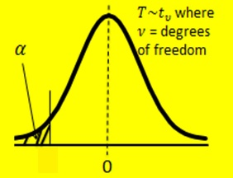
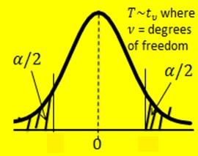
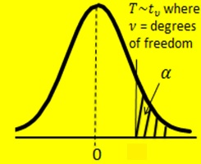

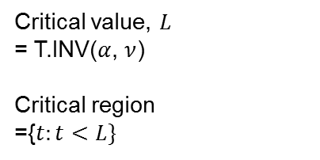

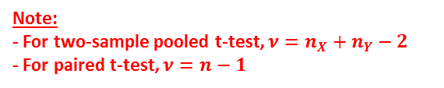


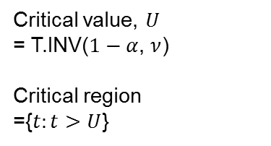




Critical Value(s) and Critical Region for T Test Statistic
$H_{0}:μ_{X}−μ_{Y}=δ$
$H_{1}:μ_{X}−μ_{Y}<δ$
Or
$H_{0}:μ_{D}=δ$
$H_{1}: μ_{D}<δ$
$H_{0}:μ_{X}−μ_{Y}=δ$
$H_{1}:μ_{X}−μ_{Y}≠δ$
Or
$H_{0}:μ_{D}=δ$
$H_{1}: μ_{D}≠δ$
$H_{0}:μ_{X}−μ_{Y}=δ$
$H_{1}:μ_{X}−μ_{Y}>δ$
Or
$H_{0}:μ_{D}=δ$
$H_{1}: μ_{D}>δ$
(Lower-tailed test)
(Two-tailed test)
(Upper-tailed test)
$$L$$
$L$
$$U$$
$$U$$
Lower critical value, $L$
= T.INV($\frac{α}{2},ν)$
Upper critical value, $U=−L$
Alternatively:
$u$ = T.INV.2T($α$, $ν$)
$L$ = $−U$
Critical region
= {$t$: $t$ < $L$ or $t$ > $U$}
Critical value, $U$
= T.INV($1−α$, $ν$)
Critical region
={$t:t>$ $U$}
Critical value, $L$
= T.INV($α$, $ν$)
Critical region
={$t:t<L\}$
Note:
- For two-sample pooled t-test, $ν=n_{X}+n_{Y}−2$
- For paired t-test, $ν=n−1$
20

Slide 21





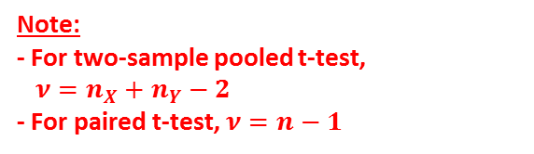






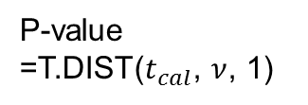

P-value for T Test Statistic
$H_{0}:μ_{X}−μ_{Y}=δ$
$H_{1}:μ_{X}−μ_{Y}<δ$
Or
$H_{0}:μ_{D}=δ$
$H_{1}: μ_{D}<δ$
$H_{0}:μ_{X}−μ_{Y}=δ$
$H_{1}:μ_{X}−μ_{Y}≠δ$
Or
$H_{0}:μ_{D}=δ$
$H_{1}: μ_{D}≠δ$
$H_{0}:μ_{X}−μ_{Y}=δ$
$H_{1}:μ_{X}−μ_{Y}>δ$
Or
$H_{0}:μ_{D}=δ$
$H_{1}: μ_{D}>δ$
(Lower-tailed test)
(Two-tailed test)
(Upper-tailed test)
$$T\sim t_{ν}$$
p-value
$$T\sim t_{ν}$$
p-value
$$T\sim t_{ν}$$
p-value
$$t_{cal}$$
0
-${|t}_{cal}|$
0
$${|t}_{cal}|$$
0
$$t_{cal}$$
P-value
=T.DIST($t_{cal}$, $ν$, 1)
P-value
=2*T.DIST(-|$t_{cal}$|, $ν$,1)
or
T.DIST.2T(|$t_{cal}$|, $ν$)
P-value
=1-T.DIST($t_{cal}$, $ν$, 1)
or
T.DIST.RT($t_{cal}$, $ν$)
Note:
- For two-sample pooled t-test,
$$ν=n_{X}+n_{Y}−2$$
- For paired t-test, $ν=n−1$

Slide 22
Solving Scenario Tasks (Test B)
[Team discussion & activity]
From the scenario given earlier (Test B), Bernice wants to find out whether the bone densities of Singaporean males and females aged between 18 to 25 years are significantly different.
Consider the following:
State the hypotheses. Define the use of variables clearly.
What is a suitable statistical test to conduct? What are the necessary assumptions? Decide on an appropriate level of significance.
Compute the test statistic, critical region and p-value.
Can the null hypothesis be rejected? State a formal conclusion in the context of the scenario. Interpret the results.

Slide 23
Solving Scenario Tasks (Test B)
[Solution]

Slide 24
Solving Scenario Tasks (Test B)
[Solution]

Slide 25
Solving Scenario Tasks (Test B)
[Solution]

Slide 26
Scenario: Test C
Collin came across a new brand of calcium supplement produced by a health product manufacturer and endorsed by a local hospital. The manufacturer claims that consumption of their new brand of calcium supplement for three months will increase bone density.
Collin wants to conduct a test to validate the manufacturer’s claim. He worked with the hospital to conduct a trial with 10 participants, both male and female included. The bone density for each participant is recorded before taking the calcium supplement and three months after the supplement is taken. The sample data collected is in the Excel spreadsheet below. Help Collin conduct a suitable test.
26

Slide 27
Independent VS Dependent Populations
Independent
Dependent
Independent data sources
Test statistic uses difference between the 2 sample means
The population parameter of interest is
Hypothesis test is called two-sample test
Same data source
Paired/matched
Repeated measures (Before/after)
Test statistic uses difference between each pair of observations
D_{i} = X_{1i} - X_{2i}
The population parameter of interest is
Hypothesis test is called paired t-test
$$\overline{X}−\overline{Y}$$
$$μ_{X}−μ_{Y}$$
$$μD$$

Slide 28
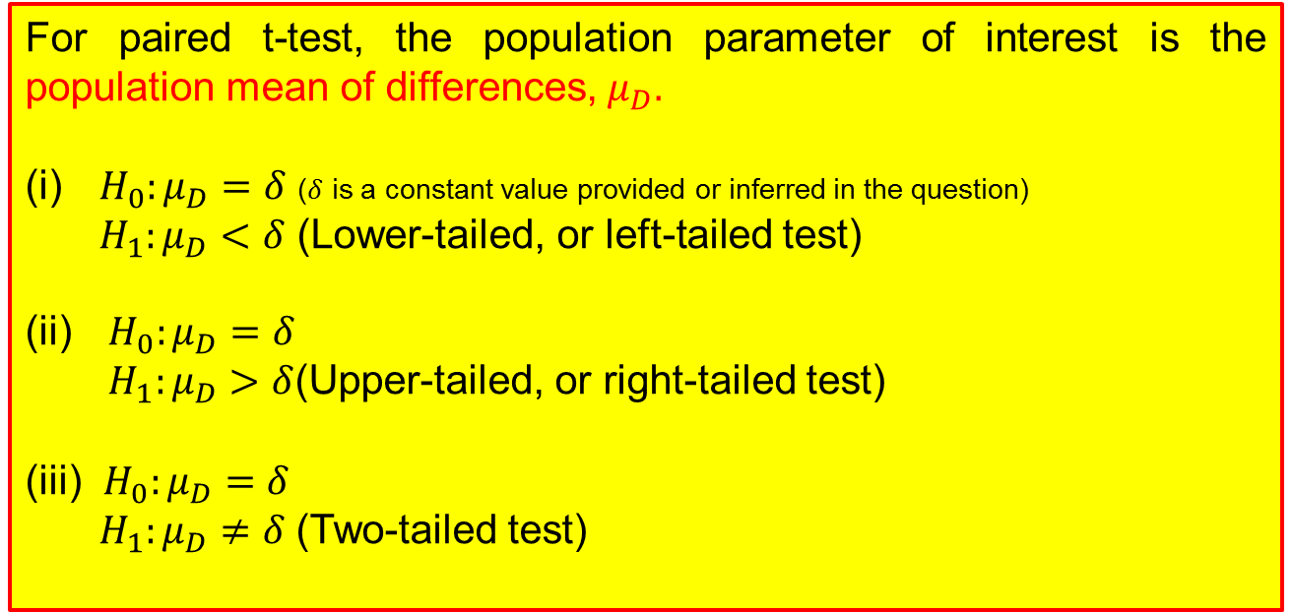
Paired t-Tests for Population Mean of Differences (for Dependent Populations): Formulation of Null and Alternative Hypotheses
For paired t-test, the population parameter of interest is the population mean of differences, $μ_{D}.$
(i) $H_{0}:μ_{D}=δ$ ($δ$ is a constant value provided or inferred in the question)
$H_{1}:μ_{D}<δ$ (Lower-tailed, or left-tailed test)
(ii) $H_{0}:μ_{D}=δ$
$H_{1}:μ_{D}>δ$(Upper-tailed, or right-tailed test)
(iii) $H_{0}:μ_{D}=δ$
$H_{1}:μ_{D}≠δ$(Two-tailed test)

Slide 29
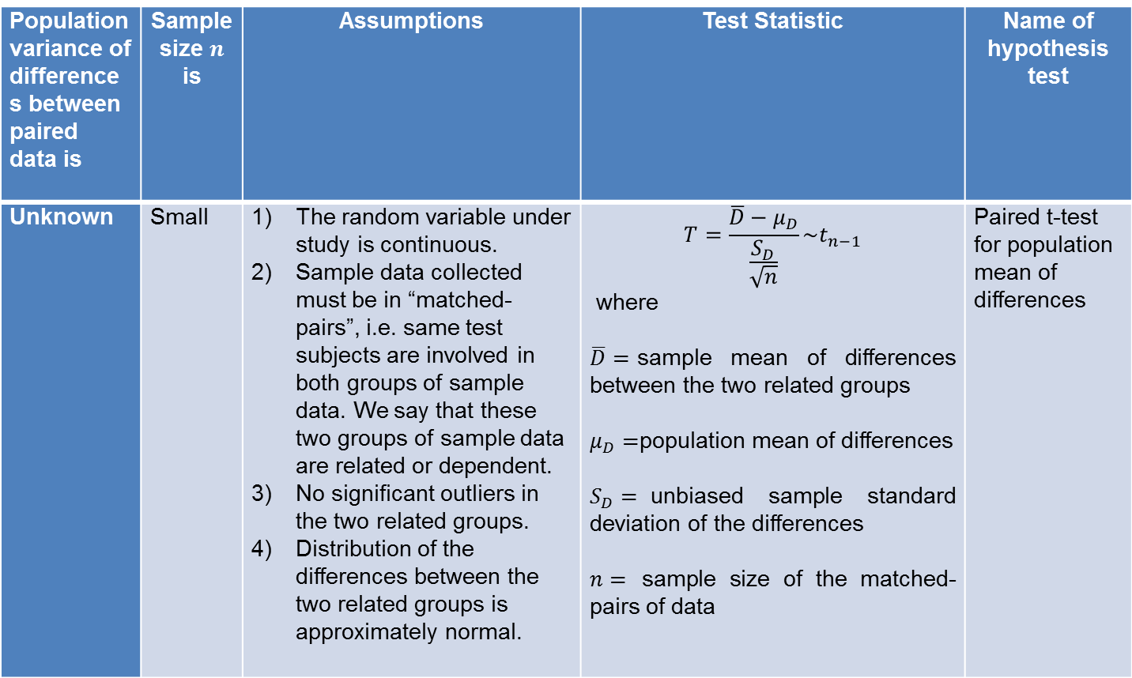
Paired t-test for Population Mean of Differences: Test Statistic
Population variance of differences between paired data is | Sample size $n$ is | Assumptions | Test Statistic | Name of hypothesis test
Unknown | Small | The random variable under study is continuous. Sample data collected must be in “matched-pairs”, i.e. same test subjects are involved in both groups of sample data. We say that these two groups of sample data are related or dependent. No significant outliers in the two related groups. Distribution of the differences between the two related groups is approximately normal. | $$T=\frac{\overline{D}−μ_{D}}{\frac{S_{D}}{\sqrt{n}}}\sim t_{n−1}$$ where $\overline{D}=$sample mean of differences between the two related groups $μ_{D}=$population mean of differences $S_{D}=$unbiased sample standard deviation of the differences $n=$ sample size of the matched-pairs of data | Paired t-test for population mean of differences

Slide 30
Solving Scenario Tasks (Test C)
[Team discussion & activity]
From the scenario given earlier (Test C), Collin wants to validate the manufacturer’s claim that consumption of their new brand of calcium supplement for three months will increase bone density.
Consider the following:
State the hypotheses. Define the use of variables clearly.
What is a suitable statistical test to conduct? What are the necessary assumptions? Decide on an appropriate level of significance.
Compute the test statistic, critical region and p-value.
Can the null hypothesis be rejected? State a formal conclusion in the context of the scenario. Interpret the results.

Slide 31
Solving Scenario Tasks (Test C)
[Solution]

Slide 32
Solving Scenario Tasks (Test C)
[Solution]

Slide 33
Solving Scenario Tasks (Test C)
[Solution]

Slide 34
Application of Data Analysis in Excel
The two-sample z-test, two-sample pooled t-test and paired t-test can be conducted in Microsoft Excel using the Data Analysis tool (available in the Analysis Toolpak)
Refer to the following guides to
Add Data Analysis to Excel
Perform two-sample pooled t-test (assuming equal variances)
Apply Data Analysis in Excel to the 3 tests and compare your results to those obtained previously

Slide 35
Application of Data Analysis in Excel
[Solution]

Slide 36
Assumption of Equal Population Variances for Two-sample t-Test : Reasonable?
In the two-sample pooled t-test, the population variances are unknown, so often we do not know if the variances can be assumed to be equal.
If the population variances are very different, the two-sample pooled t-test may not be accurate as the results may be influenced by the difference in the variances.
However, the two-sample pooled t-test is not overly sensitive to small differences between population variances, so most of the times this test can be used.
We may examine the unbiased sample variances. As a rule of thumb, if the ratio is 4 times or more, then we cannot assume the population variances to be equal.
We can also apply a hypothesis test to statistically check whether two populations have equal variances—the focus of next problem (W10).

Slide 37
Learning Objectives
Perform two-sample Z-test and two-sample t-test assuming unknown but equal variances (two-sample pooled t-test) for two independent populations
Identify the difference between independent and related (dependent) populations
Perform paired t-test for two dependent populations

